Slide 1
SoK: Detecting Adversarial Examples Against Machine Learning Systems Nicholas Lunsford

Slide 2
Problem Statement
Adversarial Defense
Model Robustness
Defenses thought of in three ways
Modify the model (increase robustness)
Manipulate Inputs (sanitize perturbations)
Detect Attack
Most focus is on robustness
Carlini and Wagner, “Adversarial Examples are Not Easily Detected”
Still great value in the detection problem
Attack Detection
Input Manipulation

Slide 3
Adversarial Examples are Not Easily Detected
Recommendations
Carlini and Wagner, 2018
Bypass 10 different detection mechanisms
Range of approaches/techniques
Speaks to the nature of adversarial examples
As title implies, adversarial examples are hard to detect
Evaluate using a strong attack.
Demonstrate white-box attacks (adaptive) fail.
Report false positive and true positive rates.
Evaluate on more than MNIST.
Release source code.

Slide 4
Sourcing Proposed Detection Methods
Filtered for papers from 2017 – 2021
Post C&W, assumption they covered SOTA at the time
Perceptual data focus (static images)
58 papers sampled
Possibly missed good papers:
Generally only looked at papers with “adversarial example” and “detect” in title
Some methods for audio or video samples may transfer well to static images

Slide 5
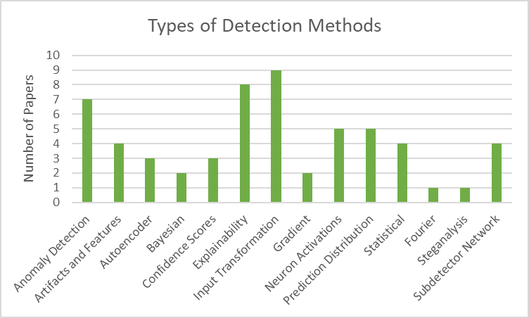
Approaches
58 Total Papers
Not all papers fit nicely into one type of approach, this graph gives general outlook
Many papers do not follow the basic criteria outlined by C&W
Only evaluate on MNIST
Use only FGSM
No adaptive considerations

Slide 6
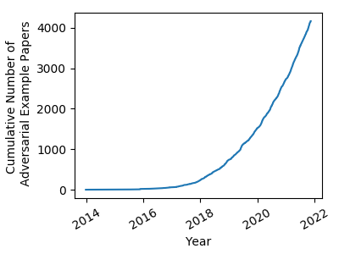
Featured Selections
Lee, Lee, Lee and Shin (2018)
Mahalanobis distance
Yang et al. (2020)
Feature attribution (ML-LOO)
Freitas, Chen, Wang, and Chau (2020)
Robust feature alignment (UnMask)
Kiani et al. (2021)
Generative views and perturbation amplification (Argos)
Xu, Evans, and Qi (2018)
Feature Squeezing

Slide 7
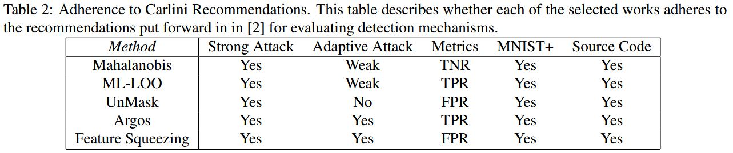
Featured Selections

Slide 8
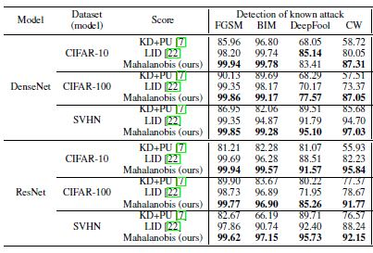
Mahalanobis Distance
Measure of distance between a point and distribution
Derive class-conditional Gaussian distributions from the softmax classifier
Add slight noise to sample
Ensemble scores from each layer of the model
Calculate Mahalanobis distance between sample and closest class distribution
Determine classification based on some threshold

Slide 9
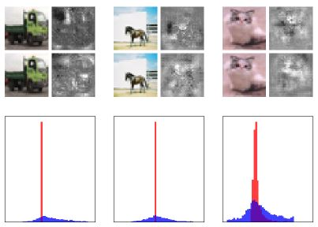
ML-LOO
Feature Attribution – scores features of an input sample based upon their importance to the sample’s classification
AE have large dispersion of feature attribution scores compared to natural samples
Quantify this dispersion and make determination based upon a threshold
Incorporates neurons at multiple layers, and requires logistic regression for weighting
Row 1: Natural Sample and Feature Attribution
Row 2: Adversarial Example and Feature Attribution
Row 3: Feature Attribution dispersions (blue – adv.)

Slide 10
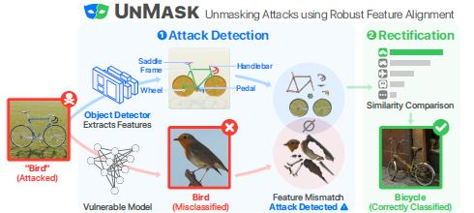
UnMask
Leverages robust features
Useful, useful not robust, robust
Idea that AEs do not attack individual features
Use an object detector to extract robust features (e.g. a bird’s beak)
Compare the robust features from the sample to the expected robust features of predicted class
Jaccard similarity score threshold to make determination

Slide 11
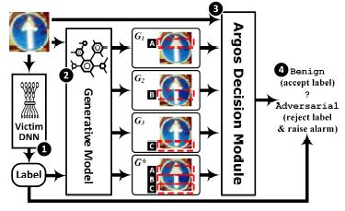
Argos
Two “souls” in an AE
Visible, semantic content – correct label
Invisible perturbation – incorrect label
Amplify the inconsistency between these two souls by generating many “views”
Seeded with input, predicted label
Measure the discrepancies between the generated views and original sample
Generated views will look different than original sample

Slide 12
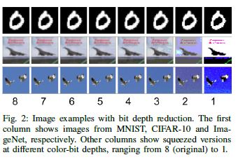
Feature Squeezing
Reduce the input feature space, and therefore attack surface
Color bit depth
Smoothing
Compare prediction vector outputs from target model on original sample and squeezed
L-1 norm
Large distance score entails adversarial image

Slide 13
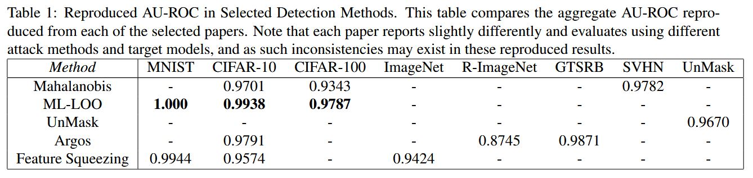
Reproduced Performance

Slide 14
Comparison Challenges
Datasets
More complex than MNIST, but different across defenses
Different attack methods evaluated
Different target models
ResNet or DenseNet
Reporting metrics
All give AU-ROC
Some include false adversarial examples, some do not

Slide 15
Evening the Playing Field
Begin by confirming test results
Implement detections
Reproduce results as published
Evaluate detection methods equally
Same model
Same adversarial examples
Same metrics

Slide 16
Challenges to Evaluating Evenly
Everything written in different libraries with different requirements
Working with both Pytorch and Tensorflow
Lack of GPU access
No APIs
Research work is not designed to be used in conjunction with other research works
UnMask requires labeled bounding boxes

Slide 17
Conclusions
Most effective detections might not be related to adversarial examples
Anomaly detection and out-of-distribution detection
Most proposed methods still do not contain proper evaluations
No adaptive adversary consideration (or strawman adversaries)
Weak attack methods
Many papers look great in an abstract, but are poor when read in detail.
Feature-based approaches might be most challenging for an attacker to bypass
Adversarial examples are not easily detected, but they are detectable.

Slide 18
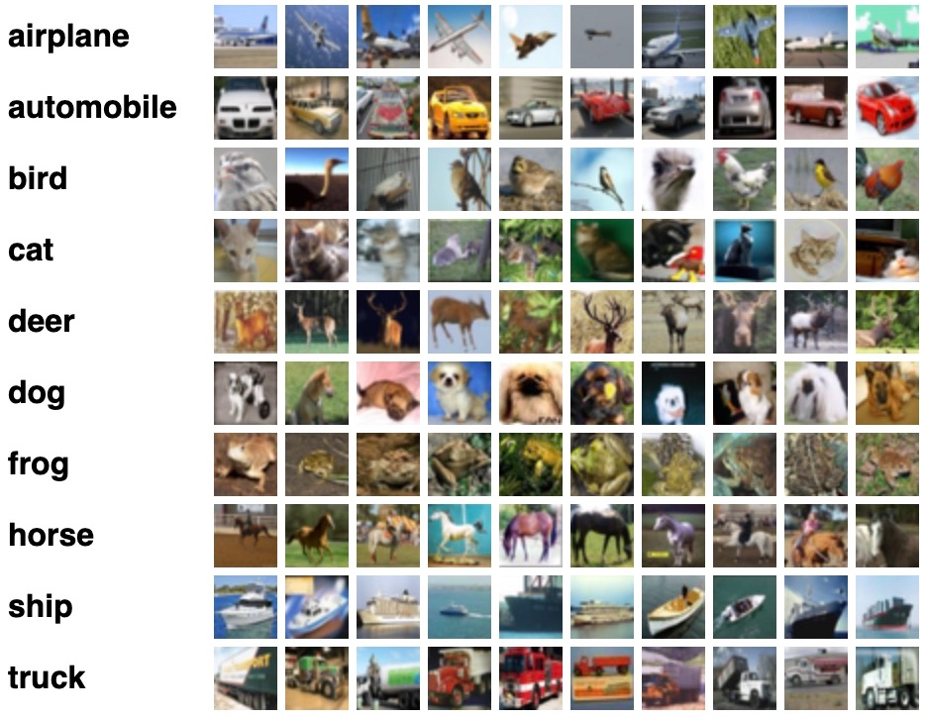
Recommendations
Make a legitimate effort at an adaptive attack.
Niche datasets should be avoided in favor of CIFAR and ImageNet
Published works should include reproducibility guidelines.
Ensemble many methods

